Slide 1
Towards generic Visual-Inertial Odometry
Julian Surber
Semester Thesis
Supervised by Margarita Chli & Lucas Pinto Teixeira

Slide 2
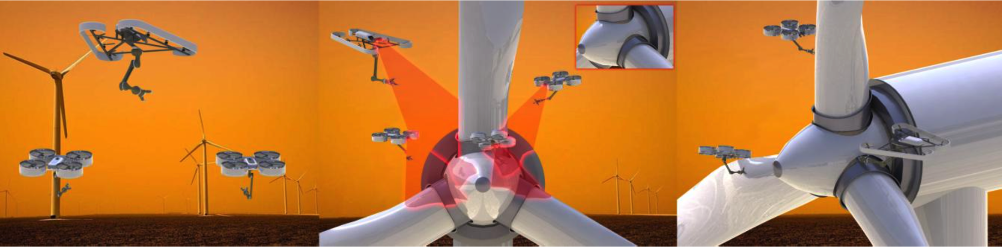
One key challenge: Single Robot Localization
Global and Local
Visual-Inertial Odometry
Complementary Properties
Lightweight
Passive
Onboard

Slide 3
ROVIO and OKVIS
Time-Synchronization
Outlook

Slide 4
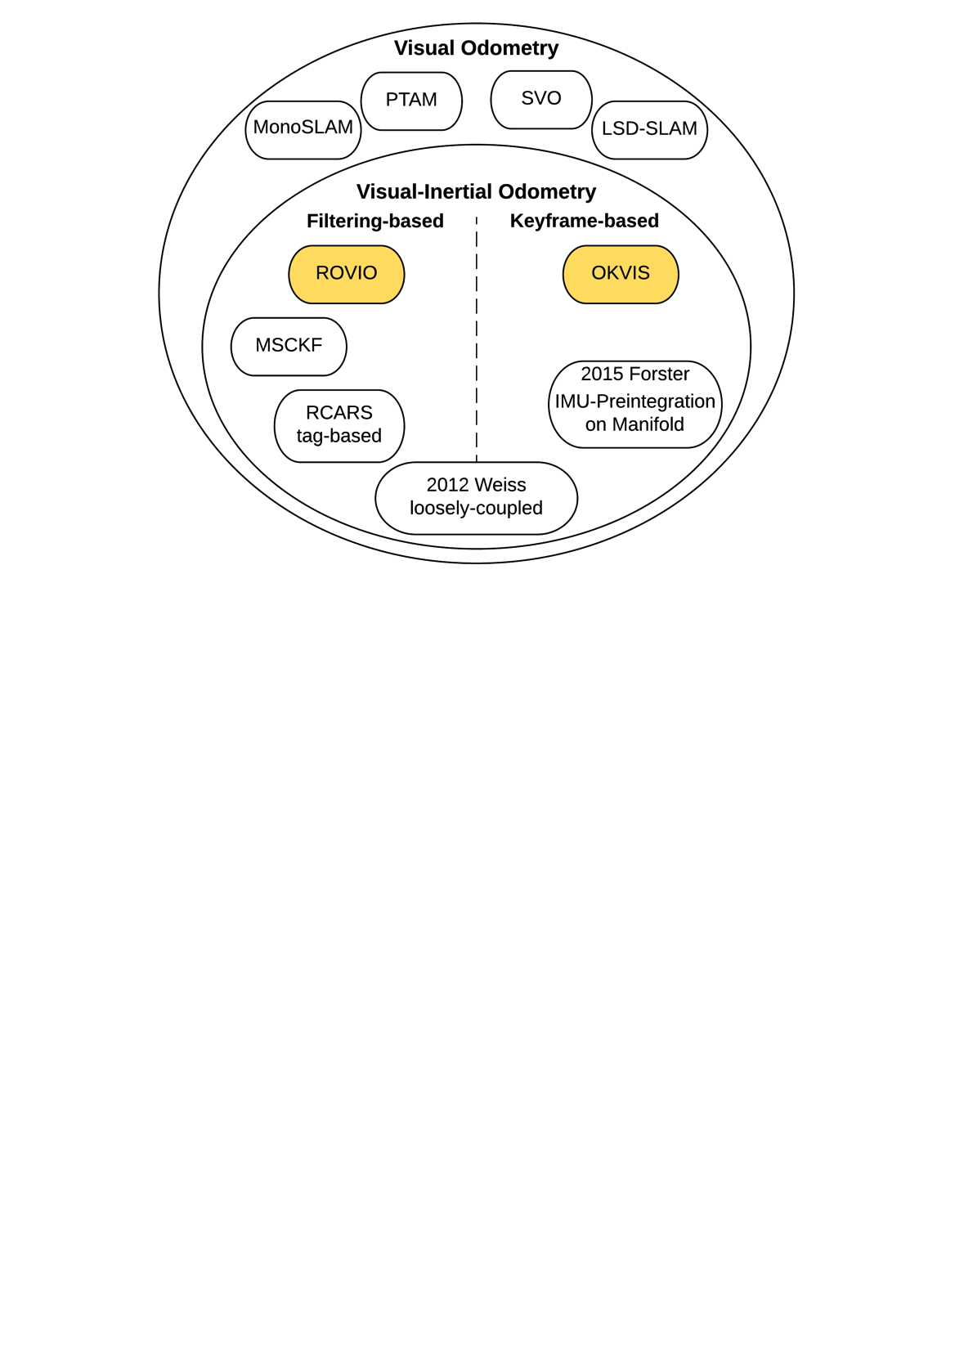
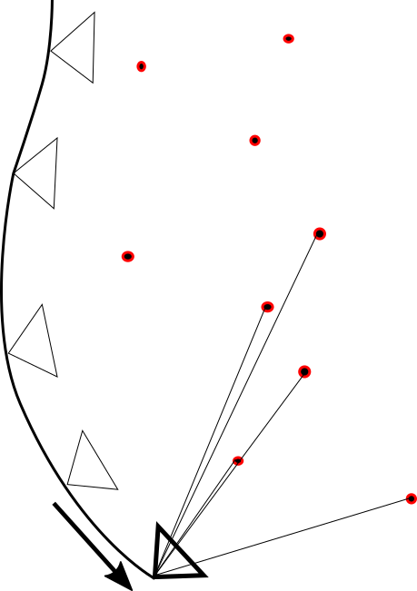
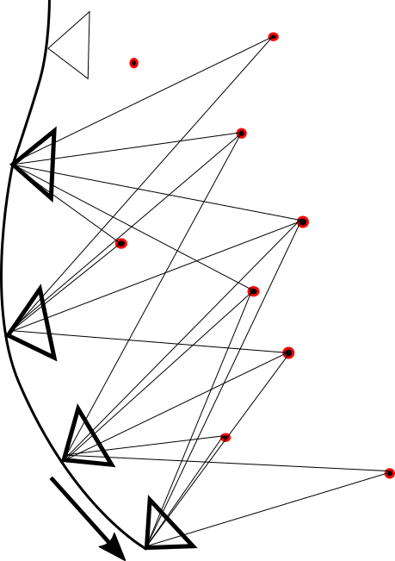
Overview
ROVIO and OKVIS
Time-Synchronization
Outlook
¹
²
¹ [Blösch et al., IROS, 2015]
² [Leutenegger et al., IJRR, 2015]
Notes:
Filtering-based: 2 steps ...
The information of a past observation is transferred into the Current Frame via the Prior Belief of the Filter.
But a Past Estimate will never be corrected based on the current observation.
Keyframe-based: nonlinear optimization based on a large number of landmark observations taken from a SET of past keyframes and the current frame.
Like that poses of the past are corrected based on the current observation.
ROVIO and OKVIS

Slide 5
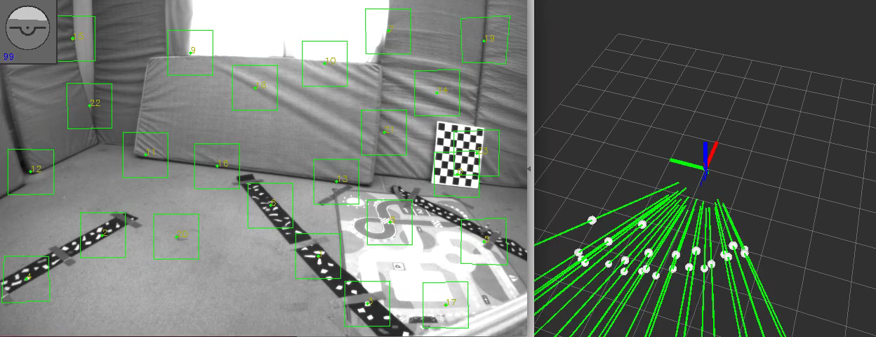
ROVIO – Robust Visual Inertial Odometry Using a Direct EKF-Based Approach
ROVIO and OKVIS
Time-Synchronization
Outlook
Fast Corner Detector / Multilevel Direct Intensity Patch Features

Slide 6
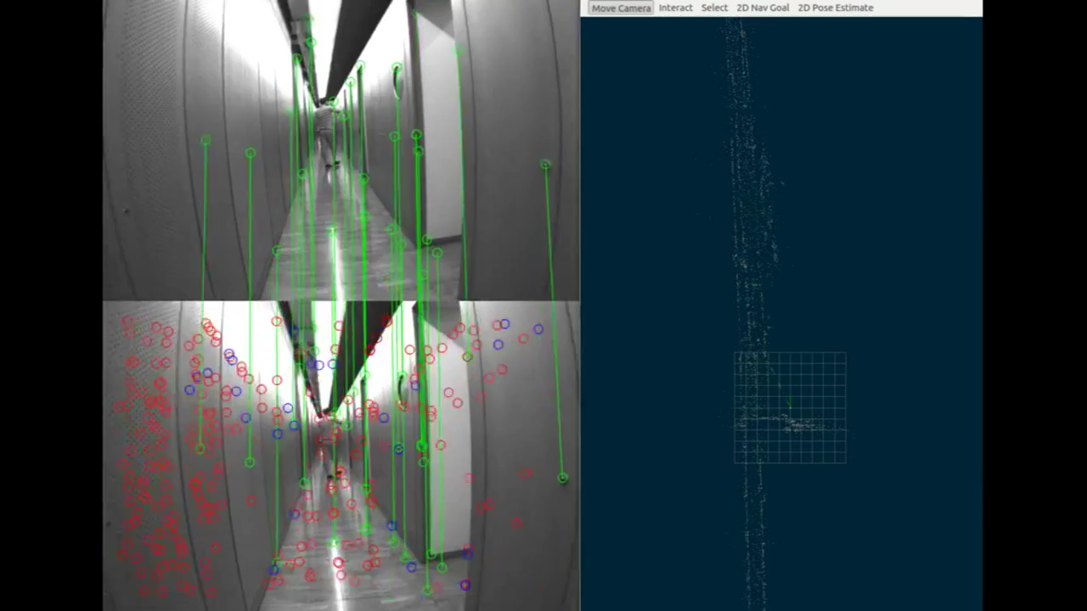
OKVIS – Optimal Keyframe-Based VI SLAM
ROVIO and OKVIS
Time-Synchronization
Outlook
[Leutenegger et al.,
IJRR, 2015]
Harris Corner Detector / BRISK Descriptor
Nonlinear Optimization

Slide 7
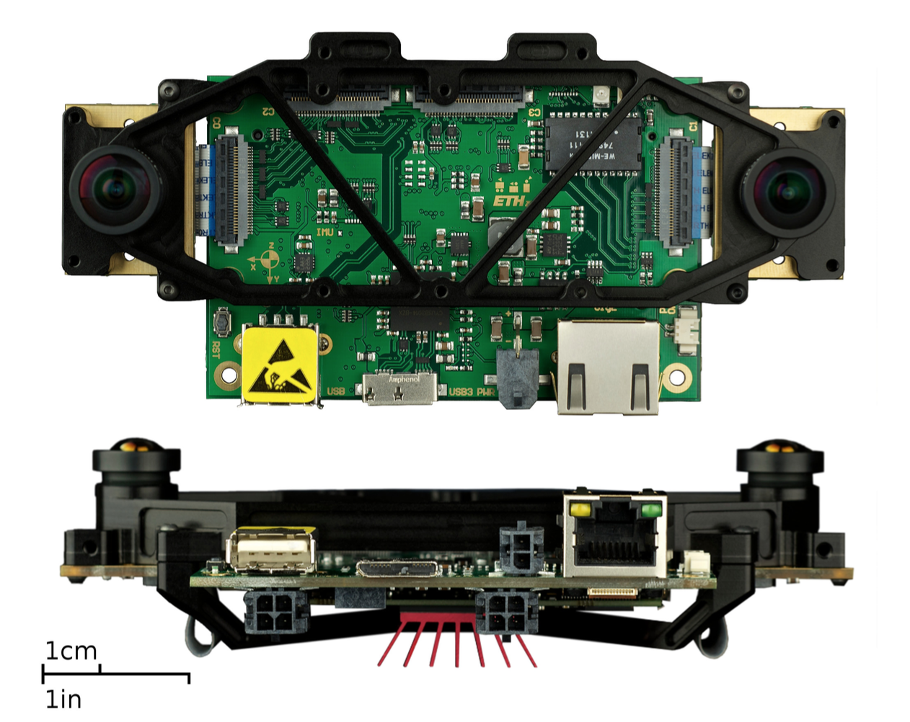
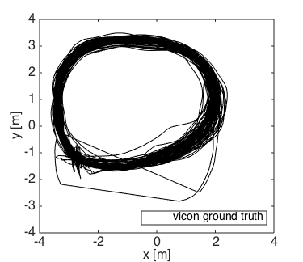
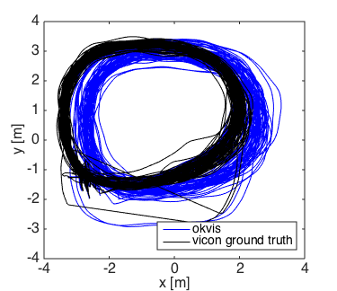
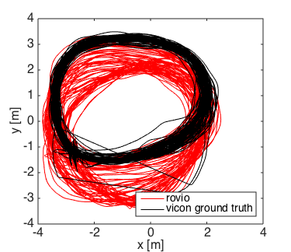
Comparison
ROVIO and OKVIS
Time-Synchronization
Outlook
Start /
Endpoint
[Nikolic et al., ICRA, 2014]
VI Sensor
Distance 1200 m, handheld, 100 Loops
Dynamics: 2 m/s, 3 rad/s
Notes:
I want to compare the two presented algorithms on a dataset Simon Lynen collected to evaluate OKVIS.
long trajectory captured indoors, 100 handheld loops
It is not clear out of this graph, but what happened was

Slide 8
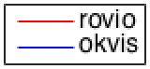
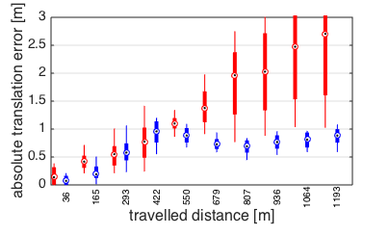
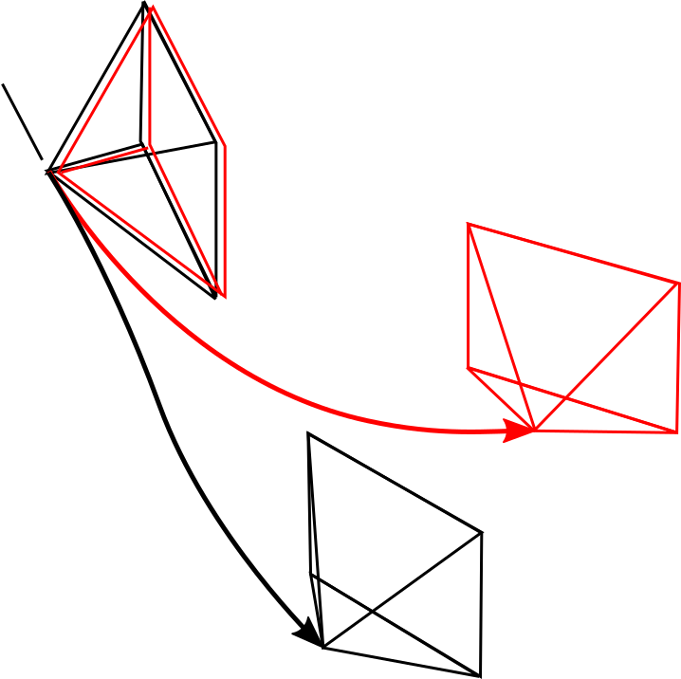
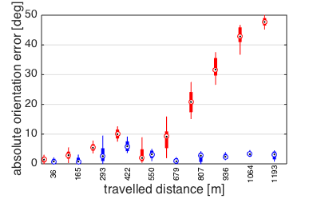
Global Accuracy
ROVIO and OKVIS
Time-Synchronization
Outlook
Notes:
If you look at the orientation error at the axes separately, the roll and pitch errors are bounded and below 1 degree for both algorithms over the whole sequence. Thanks to the IMU the gravity vector is observable and therefore errors around axes lying in the horizontal plane are bounded.
The major contribution to the absolute orientation error is coming from the yaw error – the rotation around the world-z axis.

Slide 9
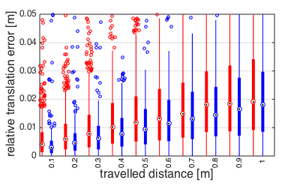
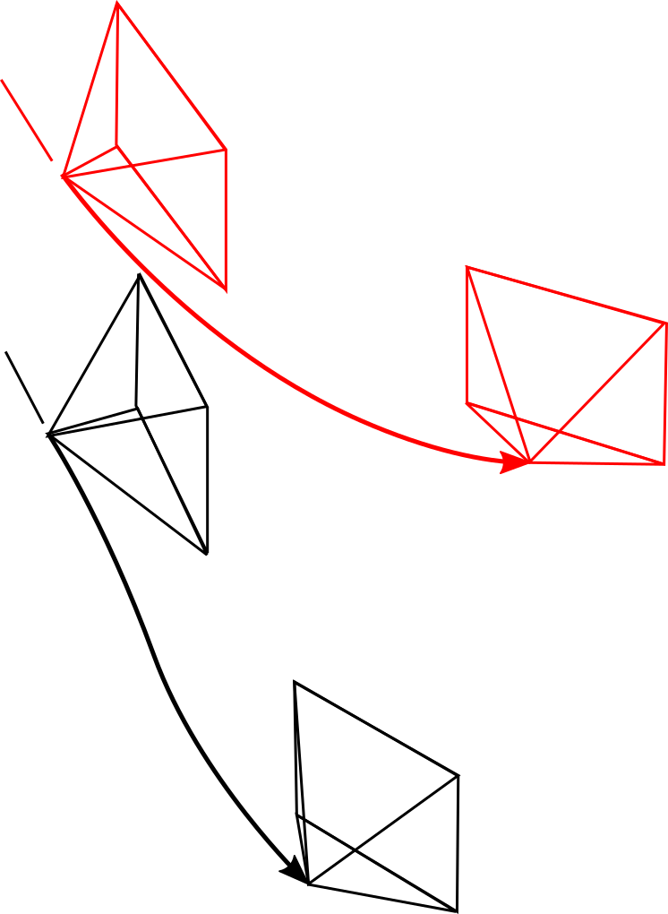
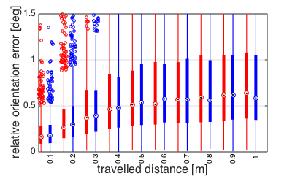
Local Accuracy
ROVIO and OKVIS
Time-Synchronization
Outlook
Notes:
In addition to the Global Accuracy it is of great interest how well tracking is working on short distances.
The relative translation error compares the true and estimated Travelled Distance between two frames.
The relative orientation error compares the true change in attitude with the estimated change in attitude between two frames.

Slide 10
Results
ROVIO and OKVIS
Time-Synchronization
Outlook
Absolute Error
ROVIO | OKVIS
2.5 m / 1000 m | 1 m / 1000 m
45 ° / 1000 m | 4 ° / 1000 m
Relative Error
ROVIO | OKVIS
2 cm / 1 m | 2 cm / 1 m
0.6 ° / 1 m | 0.6 ° / 1 m
Computational Complexity
ROVIO | OKVIS
10 ms / Frame | unknown, higher
Notes:
Gap in Global Accuracy
Similar Local Accuracy
Regarding Computational Complexity ROVIO is
Beside of these results there is an additional “soft” argument for Rovio: It is working robustly for many people in here – live with the visensor, in simulation and on other different datasets I was working on.

Slide 11
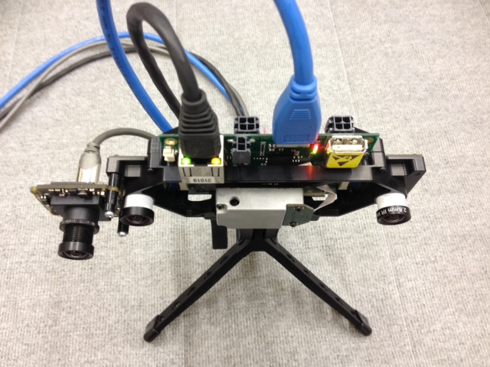
Towards non-timesynchronized Hardware
ROVIO and OKVIS
Time-Synchronization
Outlook
Notes:
Go over to the second part, where I takle the question if Visual-Inertial Odometry is able to work with data from non-timesynchronized Hardware.
The VI SENSOR is hardwarewise timesynchronized, which means that the IMU is triggering the image capture and the sensor signals arrive perfectly time-aligned.
To see if Rovio can work with a non timesynchronized Sensorsystem we attached ...

Slide 12
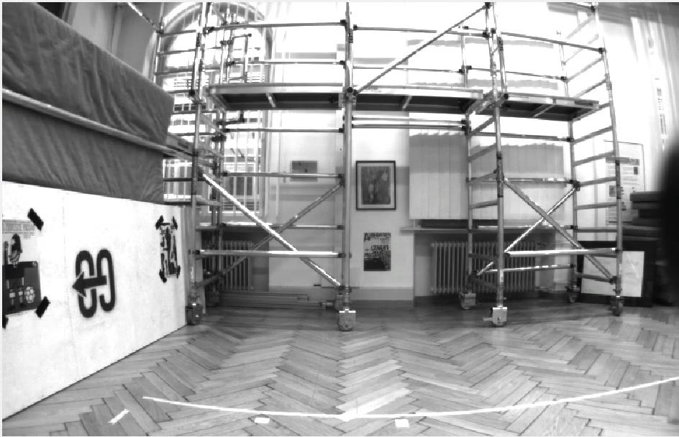
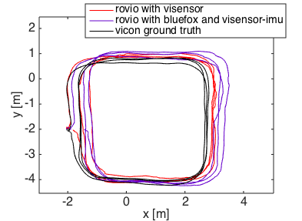
Slow Dataset
ROVIO and OKVIS
Time-Synchronization
Outlook
Dynamics: 1.5 m/s, 1 rad/s
Non-timesynchronized Hardware is able to track
Visensor performs better

Slide 13
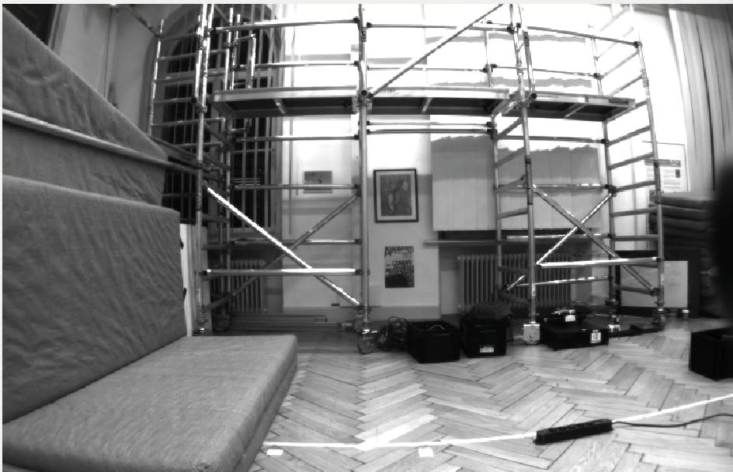
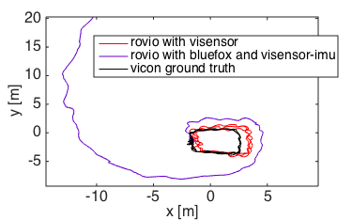
Fast dataset
ROVIO and OKVIS
Time-Synchronization
Outlook
Fast, shaky motions
Dynamics: 2.5 m/s, 5 rad/s
Non-timesynchronized Hardware diverging

Slide 14
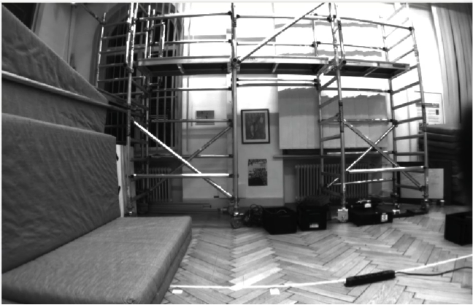
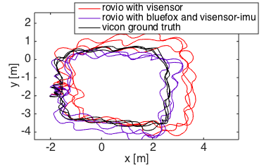
Fast dataset – Fixed Extrinsics
ROVIO and OKVIS
Time-Synchronization
Outlook
Fixing the Extrinsics can increases Rovio performance on non-timesynced Hardware

Slide 15
Outlook
ROVIO and OKVIS
Time-Synchronization
Outlook
Outlook
Rovio: Combine with a Secondary Module performing a Global Optimization
Run Rovio on embedded system with lower-quality IMU and non-timesynchronized Hardware
Run and evaluate Okvis
Notes:
Summerizing the presented work we saw, that
1) Rovio and Okvis are both promising Visual-Inertial Odometry Implementations
2) Rovio is prone to drift – especially in Yaw
3) Rovio and Okvis showed similar and good performance regarding local accuracy
4) Rovio is principally able to run on a non-hardware-timesynchronized Sensorsystem
This brings me to the outlook after this Semesterthesis.

Slide 16
Thank you !

Slide 17
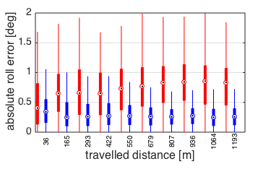
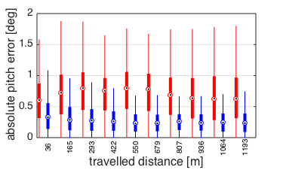
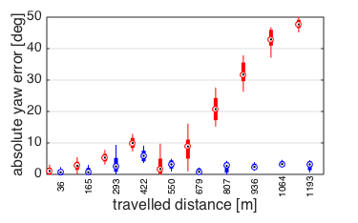
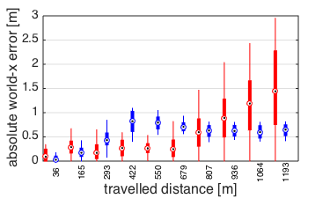
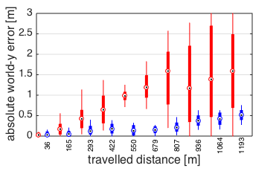
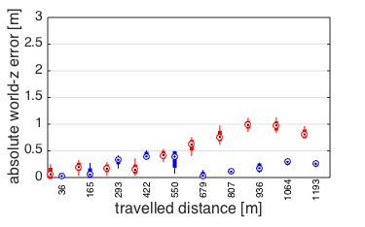
Global Accuracy – separated axes – IJRR

Slide 18
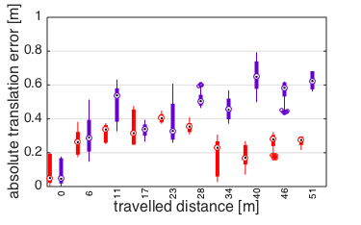
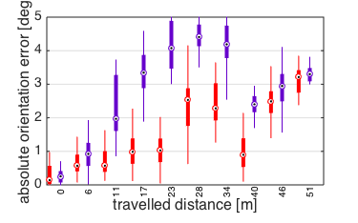
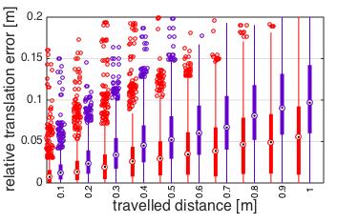
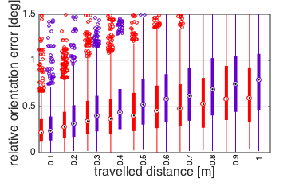
Slow Dataset

Slide 19
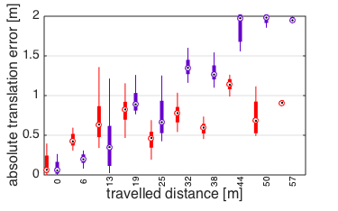
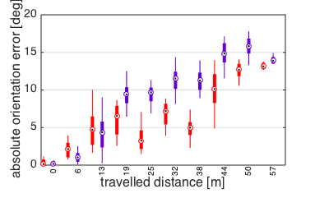
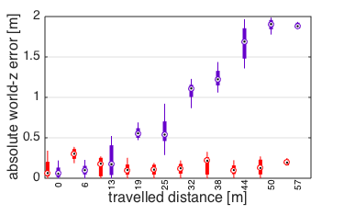
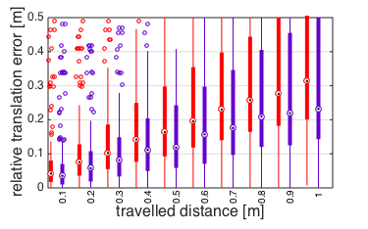
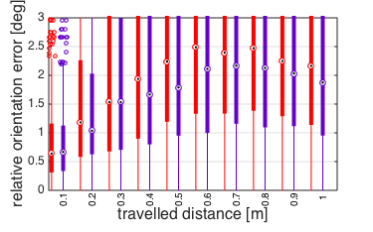
Fast dataset – Fixed Extrinsics

Slide 20
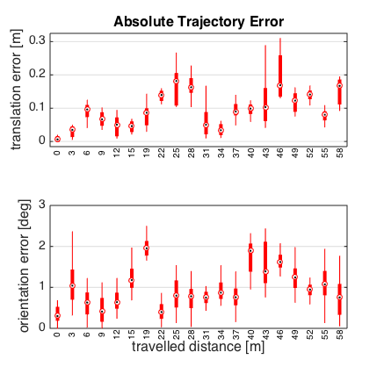
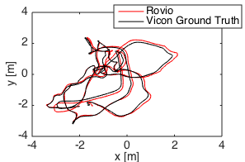
Global Accuracy ROVIO – Euroc Data

Slide 21
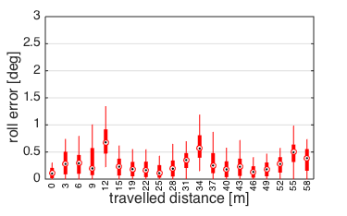
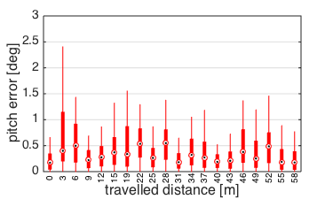
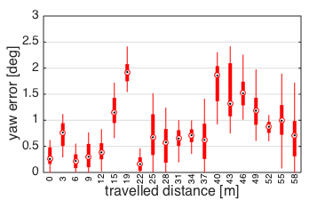
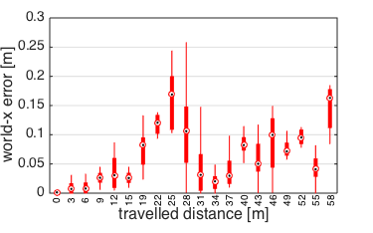
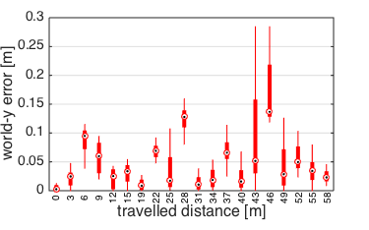
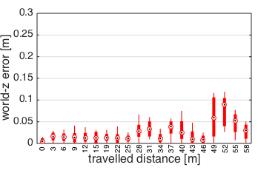
Global Accuracy ROVIO – Euroc Data
AOE_Yaw = 1 deg / 50 m
ATE_Z = 5 cm / 50 m (0.1 %)

Slide 22
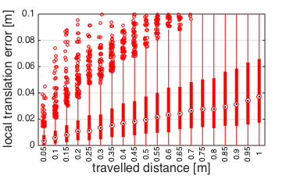
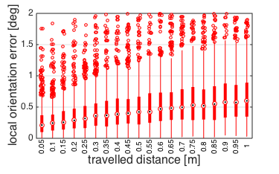
Local Accuracy ROVIO – Euroc Data
RTE = 4 cm / 1 m (4 %)
ROE = 0.6° / 1 m

Slide 23
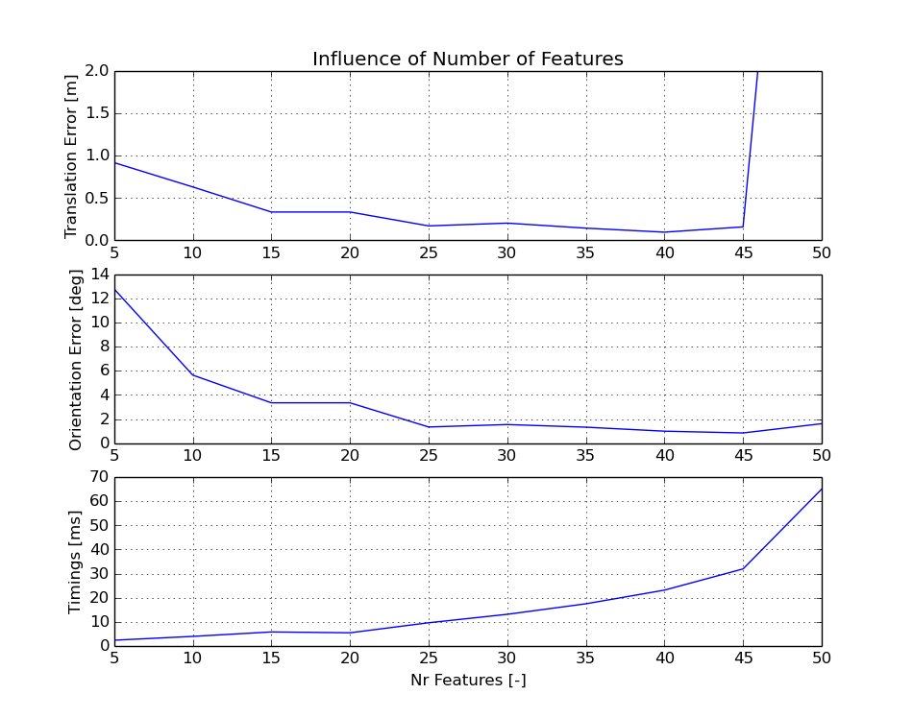
Computational Complexity / Features – Euroc Data

